Slide 1
CPT Billing Codes: An Update from the ABA Billing Codes Commission
Stephen R. Gillaspy, Ph.D.
American Psychological Association
Member, ABA Billing Codes Commission
Julie Kornack
Center for Autism and Related Disorders
Chair, ABA Billing Codes Commission
Association for Behavior Analysts International
46th Annual Convention
May 24, 2020

Slide 2
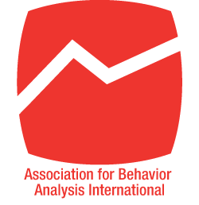
ABA Billing Codes Commission
Working together to facilitate evidence-based practices
The mission of the ABA Billing Codes Commission is to facilitate evidence-based applied behavior analysis by advancing the multi-disciplinary understanding, dissemination, and standardization of the adaptive behavior CPT® billing codes.
Notes:
ABAI believes behavior analysts should be empowered to shape behavior analysis, so it formed the ABA Billing Codes Commission to create an inclusive, multi-disciplinary group to facilitate best practices and ensure access to ABA, undiluted by billing code complexities, shortfalls, and confusion. These are the members of the ABA Billing Codes Commission.

Slide 3
ABABCC Initiatives
Dissemination of Knowledge
Resources for Practitioners, Payors, and Consumers
Multi-Disciplinary Collaboration
Communication as a Two-Way Proposition
Medically Unlikely Edits
Intended Use
Basis for Denials
National Correct Coding Initiative
Code Valuation
Carrier Pricing
RUC Survey
Rate-Setting Processes
Recurring Concerns
Concurrent Billing
Nonbillable Activities
Notes:
It’s no coincidence that the questions we received are the focus of our initiatives. {LIST]
Let’s dig into some of these points.

Slide 4
ABABCC Achievements
Launching a Website
www.ababillingcodes.com
Addressing Medically Unlikely Edits
Correspondence with National Correct Coding Initiative
Disseminating COVID Updates
Telehealth
Billing Guidance
Gaining Recognition from CMS
Medicare Telehealth List
Notes:
Website launched October 2019; maintained by the commission

Slide 5
ABA Billing Codes Commission Inquiries https://www.ababillingcodes.com/contact-us/

Slide 6
ABA Billing Codes Commission Inquiries https://www.ababillingcodes.com/contact-us/

Slide 7
Medically Unlikely Edits
Notes:
Prior to COVID, this was probably the issue that generates the most emails to the commission. In the first column – billing codes; in the second column: In the third column – adjudication indicator – this number can be a 1, 2, or 3. We want It to be a 3, and it’s a 3. What are Medically Unlikely Edits or MUE?
next

Slide 8
Medically Unlikely Edits – Intended Use
Medically Unlikely Edits (MUEs) are intended to flag potential fraud and/or billing errors by identifying the maximum number of units a provider is likely to report for a specific code in a single day for an individual patient.
MUEs are not intended to limit medically necessary treatment, and they do not eliminate the prohibition on quantitative treatment limits established by the Mental Health Parity and Addiction Equity Act (MHPAEA).
Notes:
MUE are developed by NCCI is part of CMS and it sets the MUE – surprised that commercial insurers are using the MUE since they are only intended for Medicare and Medicaid.

Slide 9
Medically Unlikely Edits – Claims Denials
Some providers are experiencing claims denials (i.e., non-payment of a claim for services rendered) on the basis that a service exceeds the MUE. This is an improper basis for a claims denial.
The MUE calls for a 3-step process, but some payors are only implementing the first step.
Flag/Deny
Review/Appeal
Pay
Notes:
Denials based on MUE improper. The MUE are intended to produce a three-step process: flag, review, pay
NEXT PAGE:
Commission contacted National Correct Coding Initiative
The letter from NCCI is on the commission website, along with other resources

Slide 10
Medically Unlikely Edits – Claims Denials
CMS has provided clear guidance to ABABCC that MUE with an MUE Adjudication Indicator of 3 may be paid in excess of the MUE if services were actually provided, properly coded, and medically necessary. All CPT I codes for adaptive behavior have a MUE Adjudication Indicator of 3.
National Correct Coding Initiative sets the MUEs.
Considering whether to update Medicare MUE for 97151
Provided guidance to ABABCC that claims denials based on MUE are improper when service was medically necessary and delivered
Appeal denials based on MUE using resources available at www.ABABillingCodes.com.
Alert ABABCC when claims denials are upheld.
Notes:
Commission contacted National Correct Coding Initiative
The letter from NCCI is on the commission website, along with other resources
Don’t write off your denials. Take the denials to the insurance commissioner for your state regulated plans
If we hear from you that the same payor is making the same denials, we will contact that payor to convey our concern and to explain the proper use of the MUE, and we will go to NCCI and explain what happens in practice, not just in theory.
All this talk about not getting paid reminds me that we should talk about valuation.

Slide 11
COVID Updates
Telehealth authorized for all codes
Includes 97153 for the first time
Guidance re Billing for Telehealth
Place of Service Code
GT Modifier
Flexibility in Guidance
Check for Updates on ABABCC Website
https://www.ababillingcodes.com/resources/important-covid-19-update-use-of-telehealth-2/
Adaptive Codes Added to Medicare Telehealth List

Slide 12
Medicare Telehealth List
All adaptive codes added by CMS to Medicare Telehealth List
Collaboration of APA and ABABCC led by APA
Significance
Minimizes claims denials
Supports efforts to use telehealth across all codes
Temporary change during COVID emergency
Effort to make change permanent

Slide 13
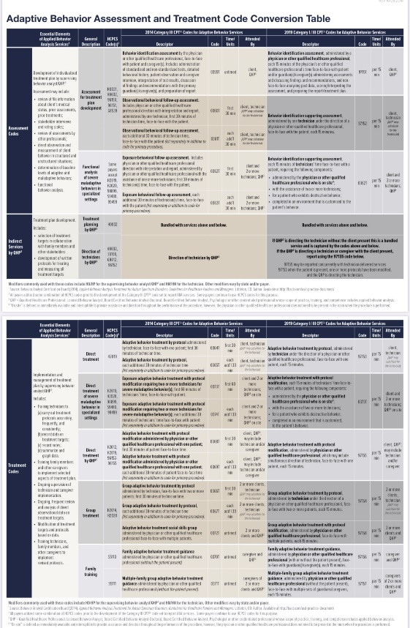
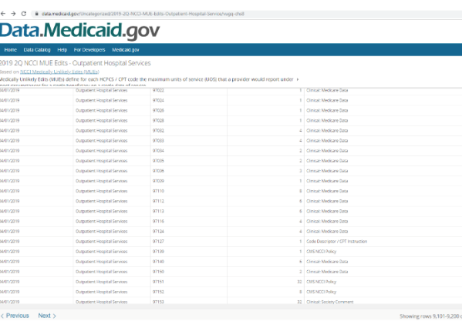
Dissemination of Knowledge Resources for Practitioners, Payors, and Consumers
Website www.ababillingcodes.com
Accessible – No Paywall
Crosswalk
Descriptors
Initiatives
COVID Updates
Contact Us
https://www.ababillingcodes.com/contact-us/
Notes:
All of the original materials that were developed, including the crosswalk and billing code descriptors.
New resources developed since the codes took effect, such as information on Medically Unlikely Edits
Please take advantage of this website. If you go on the website and you don’t find what you need, you can contact us, and we’ll answer you to the best of our ability. If we don’t have an answer, we will endeavor to find one. Your emails to the commission are the only way we learn about the issues of interest to you. They are how I decided what I would talk about today, so if my talk isn’t interesting to you, you should have emailed us!

Slide 14
Dissemination of Knowledge Multi-Disciplinary Collaboration
Diagnosticians
Physicians
Neurologists
Psychologists
AMA Professional Societies
Notes:
If we want to be involved in what happens to our codes, we have to reach out to the professionals who are part of professional societies recognized by the AMA.
These are the professionals who send their patients to behavior analysts. They struggle to find behavior analysts who can take their patients – especially if their patients are older. Health plans and insurers deny services to our patients based on their diagnostic reports. One year, a third of our denials from a large insurer were based on the insurer’s decision that the diagnostic report was insufficient. This is the partnership that will identify standardize the diagnostic report, so they are no longer the basis for denial and delays.
And this is the collaboration that will help us understand how we can amend or add to our codes in the future in a way that facilitates evidence-based ABA as you, the behavior analysts, define it.

Slide 15
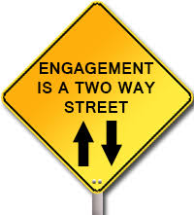
Dissemination of Knowledge Communication as a Two-Way Proposition
Opportunities to Survey the Field
What’s working?
What’s missing?
What are your priorities?
Contact ABABCC
Get answers
Get support
Share updates
Notes:
Communication should be a two-way proposition, a dialogue. For today, it’s just a one-way proposition – just me with my monologue, but after today, we want that dialogue.
What’s working: Standardization
What’s missing: Treatment planning codes, ability to bill for data analysis and other indirect activities, telehealth, unauthorized codes
What are your priorities: Right now, most of our questions have centered around indirect services, the MUE for 97151, and we expect surveys to highlight additional concerns. Look for those surveys from the commission and participate in them and promote them
Take Advantage of the Website: Lots of resources and use the contact page to get answers and support or to share updates.
Let’s get into some of those recurring questions.

Slide 16
Code Valuation
Three different options
RUC Survey: Valuation is determined through the AMA Relative Value Scale (RVS) Update Committee (RUC) process / survey.
CMS Rulemaking: Valuation occurs through rulemaking when the Centers for Medicare & Medicaid Services (CMS) assigns values and allows notice and comment of its proposed values.
Carrier Pricing: CMS does not set a value, and reimbursement rates are negotiated between providers and funding sources.
Notes:
Done through standardized surveys sent out by medical specialty societies or other professional organizations that are recognized as “stakeholders” by the AMA to members who are familiar with the services being valued.
IMPORTANT NOTE: At present no behavior analysis organizations are recognized as stakeholders.
Carrier Pricing: CPT codes are carrier-priced when a RUC survey is not completed. That can occur for several reasons:
The specialty does not feel they can obtain an adequate sample (ranges from 30 -75)
The specialty does not have a seat on the necessary panels and therefore cannot sponsor a RUC survey
The specialty elects not to survey and prefers the carrier-priced valuation

Slide 17
Code Valuation – Know Your Costs
Maximum number of hours that frontline staff will work
Time allocated for administrative supervision, in-service training, and HR training
Travel time
Salary of administrative support roles
Non-billable hours for activities not captured by billing codes (e.g., indirect work of behavior analyst)
Paid sick days, vacation, and holidays
Pre-service training hours, recruiting, and hiring
Cost of unfulfilled contract hours due to staff turnover
Cost of training, conferences, CEUs, classes, certifications, licenses, etc.
Payroll taxes, health insurance, retirement, workers’ compensation, and other benefits – separated by position – technician, assistant behavior analyst, behavior analyst, administrator, executive, etc.
Total number of FTE
Agency Overhead
Agency overhead (include PROFIT if you are a for-profit company)
HR salaries
Executive salaries
Clinical administrators, trainers, etc.
Billing and reconciling
Buildings and equipment, including computers, furniture, and utilities
Website and design
Telephone, postage,
Authorizations
Admissions
Scheduling
Credentialing
Licensing
Auditing – Internal and External
Public relations with families and insurers
Payroll and benefits administration
Legal fees
Financial audits
Unpaid bills
Depreciation and amortization
Profit
Notes:
This is intentionally a sea of words. I’m not going to spend time on this, except to say, your costs to deliver ABA aren’t limited to the hourly rate you pay a behavior technician, which is sometimes the health plan’s approach when negotiating rates. Know your costs, and understand the rates you can’t accept if you want to keep serving people.

Slide 18
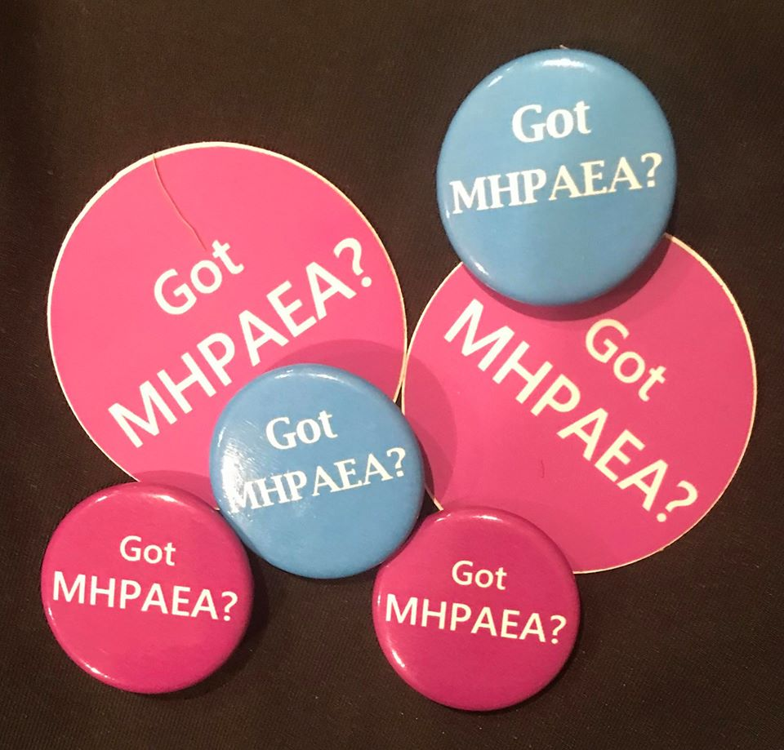
Code Valuation – Got MHPAEA?
Federal Mental Health Parity and Addiction Equity Act (MHPAEA)
Low rates are non-quantitative treatment limits that violate MHPAEA.
Arbitrary rates violate MHPAEA.
When provider networks are inadequate, rate cuts violate MHPAEA.
Notes:
MHPAEA is about parity. That means that what happens on the medical/surgical side needs to happen on the mental health services side. Rate-setting processes – insurer must demonstrate comparability in rate-setting processes
Use of out-of-network providers broadly accepted as illustrative of inadequate networks. Patients are far more likely to go out of network for mental health services than for primary care. Milliman.
Rates for primary care are considerably higher – varies from state to state and region to region

Slide 19
Concurrent Billing
Notes:
Can a behavior analyst and behavior technician bill at the same time? Well, it always depends on the payor. And this is one of the questions you need to know before you can accept a given rate. The intention of the billing codes is for concurrent billing to be permitted with these code pairs.

Slide 20
Maladaptive Behavior
Code | Potential Issues
97151 | Denials; insufficient units; failure to authorize in a timely fashion for treatment planning; limited to initial authorization
0373T | Failure to authorize the code; inadequate rate, given specialized environment and rendering individuals (2 or more BTs with a behavior analyst on-site and making a protocol modification)
97152 | Failure to authorize the code
97153 | Failure to allow concurrent billing of 97155; lack of modifier when a behavior analyst delivers 1:1 ABA
97155 | Failure to allow concurrent billing of 97153; failure to provide a modifier for remote services (telehealth); requirement for 97155 hours to be some portion of 97153 hours
97156 | Requirement to have patient present; requirement for caregiver to participate; failure to provide a modifier for remote services (telehealth)
Notes:
What are some of the most common problems we encounter with the codes? Well, here are some of the initial concerns we heard about just before the codes first took effect in January of 2019. Providers were getting insufficient units for assessment under 97151. That code was limited to the initial authorization period. The assessment code that allowed you to involve your BTs in collecting data wasn’t authorized. 373T, the code you might use when working with a patient who exhibits destructive behavior, wasn’t being authorized at all, so the insurers seemed to incentivize providers not to accept patients with complex needs; concurrent billing of 97153 and 97155 wasn’t recognized. In the family guidance code, the patient’s presence wasn’t optional.

Slide 21
Concurrent Billing vs. Duplicate Billing
Concurrent (con·cur·rent):
Happening at the same time
Duplicate (ˈd(y)o͞opləkət):
Exactly like something else
Notes:
Some payors mischaracterize concurrent billing as duplicate billing and say federal law prohibits duplicate billing. This is important because if you’re getting paid by Medicaid or TRICARE or some other federally funded program, and the billable hours of a behavior technician and behavior analyst are determined to be duplicative, that government entity either won’t pay your claim or will claw back what it has paid you. That’s the sort of scenario where the “F” word might be thrown around. That’s right – Fraud. What did you think I meant?
Fraudulent billing is a valid concern. Because ABA often requires the behavior analyst and behavior technician to work together, it’s important to understand the difference between concurrent billing – happening at the same time – and duplicate billing as it’s defined in federal policy. So let’s take a look at the definition of duplicate billing under Medicare, the federal program that drives so many payor policies.

Slide 22
Concurrent Billing vs. Duplicate Billing Medicare Guidance
For practitioner claims, a claim must have ALL of the following 8 elements in common with another claim to be considered a duplicate claim:
1. HIC Number (Medicare patient ID)
2. Provider Number
3. From Date of Service
4. Through Date of Service
5. Type of Service
6. Procedure Code
7. Place of Service
8. Billed Amount
Notes:
Insert reference
IN order for the work of a behavior analyst and a behavior technician to meet the definition of duplicate billing, 8 elements have to be the same. All 8 elements have to be the same. Same patient. Same provider number Dates of service. Type of service. Procedure code. Place of Service. Billed Amount. When a behavior analyst and behavior technician work with a patient together, there is simply no way for all 8 elements to be the same.

Slide 23
Nonbillable: Supervision Semantics
Non-Billable | Billable
Supervision | Direction of the Technician
Supervision | Adaptive Behavior Treatment with Protocol Modification
Notes:
Ideally we would stop describing the work of the behavior analyst as supervision. But at a minimum, don’t use supervision to describe billable services.
Direction of a technician includes, but is not limited to, the QHP frequently observing the technician implementing the patient’s protocols with the patient, providing instructions and confirming or corrective feedback as needed, and/or demonstrating correct implementation of a new or modified treatment protocol with the patient while the technician observes, followed by the technician implementing the protocol with the patient while the QHP observes and provides feedback.

Slide 24
Nonbillable: Indirect Services
Indirect services are those services completed without the patient present.
Indirect services are only billable under 97151.
Behavior Identification Assessment administered by a physician or other qualified health care professional, each 15 minutes of the physician’s or other qualified health care professional’s time face-to-face with the patient and/or guardians(s)/caregiver(s) administering assessments and discussing findings and recommendations, and non face-to-face analyzing past data, scoring/interpreting the assessment, and preparing the report/treatment plan.
Notes:
Indirect services are those services completed without the patient present. Sometimes, these activities comprise half of the behavior analysts’ time. But now they aren’t billable outside of the initial assessment and sometimes the reauthorization period.
97151 is the only adaptive behavior code that allows us to bill for indirect services.
The interpretation of 97151 has limited it to the initial assessment and sometimes the reassessment every 6 months.
Let’s take a look at the code descriptor. Where does it say that this code is limited to the initial assessment? The fact is that the interpretation of this code is what limits its use. What if the interpretation didn’t narrow its use so severely? Would that solve the problem of how to capture the cost of the behavior analyst’s indirect services?

Slide 25
Nonbillable: Indirect Services
97151 is “intended for reporting initial assessment and treatment plan development and reassessment and progress reporting….”
“Day-to-day assessment and treatment planning are bundled into the treatment codes….”
Notes:
When the codes were rolled out, we were taught that 97151 was intended for initial assessment…….. [READ the FAQ Quotes]
And we were told that day-to-day assessment and treatment planning were bundled into the other treatment codes.
That’s conceivably 50% of the work of the behavior analyst that became non-billable because 97151 was interpreted to be limited to the initial assessment. Did our rates double and nobody told me? if all of our indirect services became non-billable and their cost was now captured by the treatment codes, why didn’t rates go up? What if 97151 weren’t limited to the initial assessment and the reassessment? Would that fix the problem of non-billable activities of the behavior analyst? Why don’t we have a treatment planning code to make the indirect services of the behavior analyst billable?
These are the questions that we need to ask as a field. This isn’t a debate that happens between a few people over here…. If we don’t get this right, how much nonbillable work will behavior analysts be able to do? How effective will ABA be if behavior analysts think they should spend less time analyzing data? If ABA programs aren’t effective, insurers will have a reason not to authorize them. Perfect example of why we need to communicate, understand the different ways that ABA is delivered – in a home, in a center, at school – get every perspective so we make sure our billing codes work for all of us and facilitate undiluted evidence-based ABA.

Slide 26
ABABCC – What’s Next?
Telehealth – Keeping Policy Gains during COVID
Communication with payors to increase standardization
Complexity modifiers
Potential amendments
Assessment
Family Guidance
Notes:
Some of our next steps include reaching out to payors to increase standardization in the way the codes are interpreted. u tell us what’s next

